Slide 1
Sprint 3
PerlSquad

Slide 2
Recent Client Meeting
Showed our clients the progress on our one biome, the Rainforest
Discussed best ways to implement customization GUI
Came up with an event timeline to distinguish what needed to be done when.

Slide 3
What They Liked
Clients were happy with the graphically improved info screen. They thought it not only looked better but was more immersive.
They also liked our short-term/long-term ideas for handling customization

Slide 4
What Could Be Better
We still needed to improve feedback from the scroll game. They wanted to replace the score with right/wrong clicks.
They also wanted to add hover-over images to “Game Over” screen.
Lastly, they asked that we give varying levels of feedback depending on difficulty.

Slide 5
What Else We Could Improve
First, we needed to implement all biomes
Second, we needed to finish short-term customization solution (add images, check/uncheck images/text).
Third, we needed to implement the feedback changes they wanted (see last slide).
Fourth, we needed to put in help tips.
Fifth, we needed to clean up dead code and make sure analytics were adjusted with changes.

Slide 6
Changes Since Last Sprint:
We have expanded what we did for the rainforest into every biome
Game now takes you through each biome
Feedback screen for scroll game is more robust and constructive
Analytics now differentiates between the biomes to compare data between

Slide 7
Changes Since Last Sprint (Cont.):
Began to develop help page, which gives in-game tips on how to use/play the game.
Customization efforts are still underway. Images can now be uploaded and previewed. Still need to add to manifest.

Slide 8
Info Screen Changes/Improvements:
Now loads animals/background relative to selected biome
Images automatically scaled to be relatively the same size compared to one another
Next changes to add: Modify manifest so that text associated with image and image coordinates are correct.

Slide 9
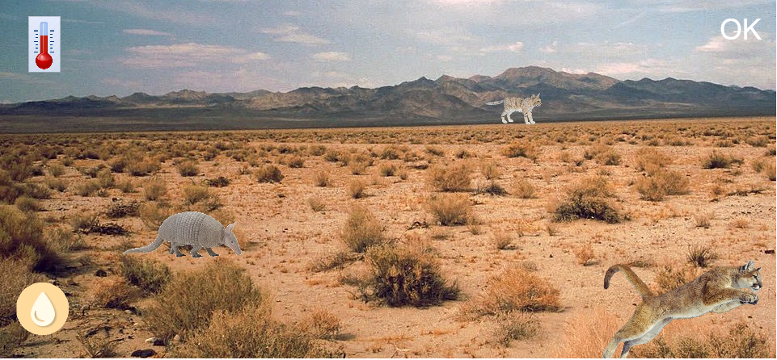
Example: Desert

Slide 10
Successes/Roadblocks
Had to change older code to work with how preloaded images were stored
Most images do not yet have associated text in the manifest.
So far, no customization options for where the images appear on the screen, so some images look out of place

Slide 11
Mini-game Changes/Improvements:
As per client feedback, at end of minigame the number of correctly/incorrectly clicked animals is displayed rather than a score
Now loads animals/background relative to selected biome
Images automatically scaled to be relatively the same size compared to one another
Next changes to add: on easy, have some notification to user that they clicked the right animal or the wrong animal and add in hover-over images on feedback screen

Slide 12
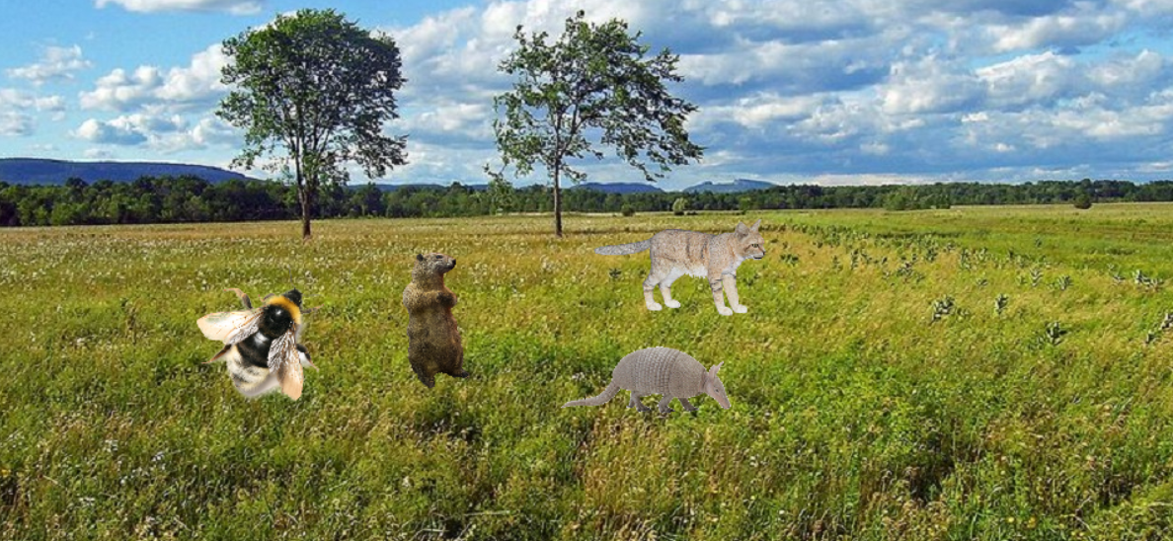
Example: Grassland

Slide 13
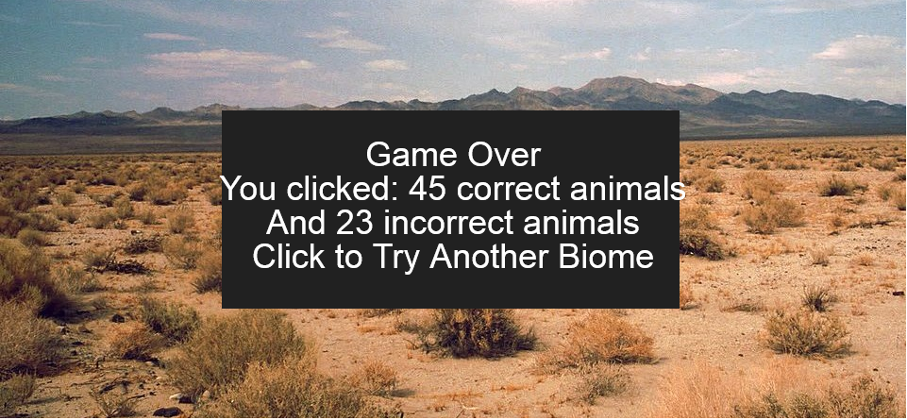
Example: Feedback Screen

Slide 14
Successes/Roadblocks
Had to change older code to work with how preloaded images were stored
Scaling back images somehow caused scrolling speed to increase dramatically - especially on hard - fixed by scaling down speed calculations
So far, no customization options for WHICH animals from the biome move across the screen, but shouldn’t be too difficult to implement in future

Slide 15
Help Screen Changes/Improvements:
Put in a nice little menu for help topics, allowing users to seek help if they’re having trouble understanding how a section of the game works.
Next changes to add: Implement a back button to allow users to exit help menu and add in the actual help text.

Slide 16
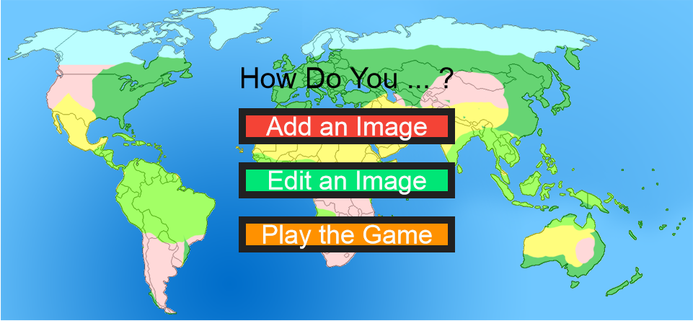
Example: Help Topics

Slide 17
Successes/Roadblocks
With customization unfinished, we weren’t 100% sure what to put in help yet.
Should there also/only be in-game help tips?

Slide 18
Add Image Changes/Improvements:
Implemented way to browse for image files in addition to entering a source.
Images can now be previewed before adding them
Next changes to add: Implement manifest editing portion of add and image/text checking/unchecking in edit

Slide 19
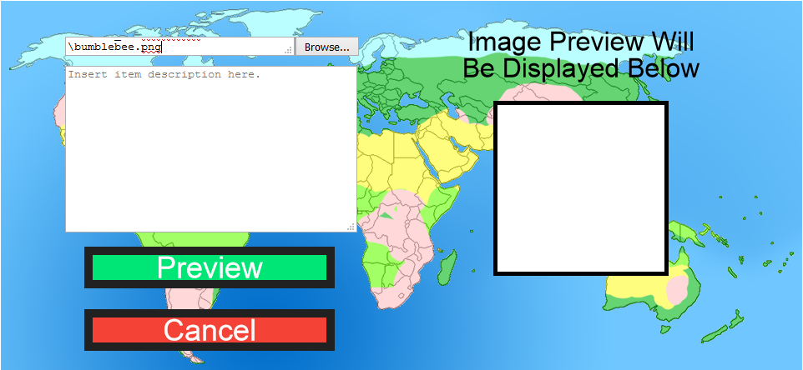
Example: Source Input

Slide 20
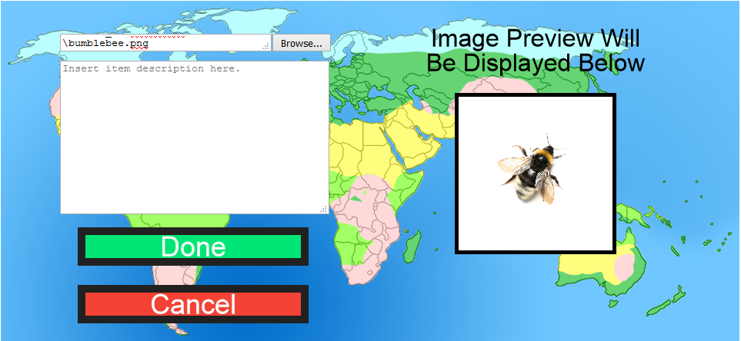
Example: Previewing

Slide 21
Successes/Roadblocks
Image previewing gives users a better idea of what the image will look like in-game.
Having both choosing a file and inputting a source path as options makes GUI more versatile
Users will still have to move the image to a certain folder for browse to work.

Slide 22
Future Plans
Deploy and collect analytics from first the clients’ grad students and then the young students
Continue with customization efforts and deploy them ASAP
Improve manifest and utilize it to make info screen prettier

Slide 23
Future Plans (Cont.)
Add in leveled mini-game feedback and improve “Game Over” screen
Implement more help tips both in start menu and in-game

